Slide 1
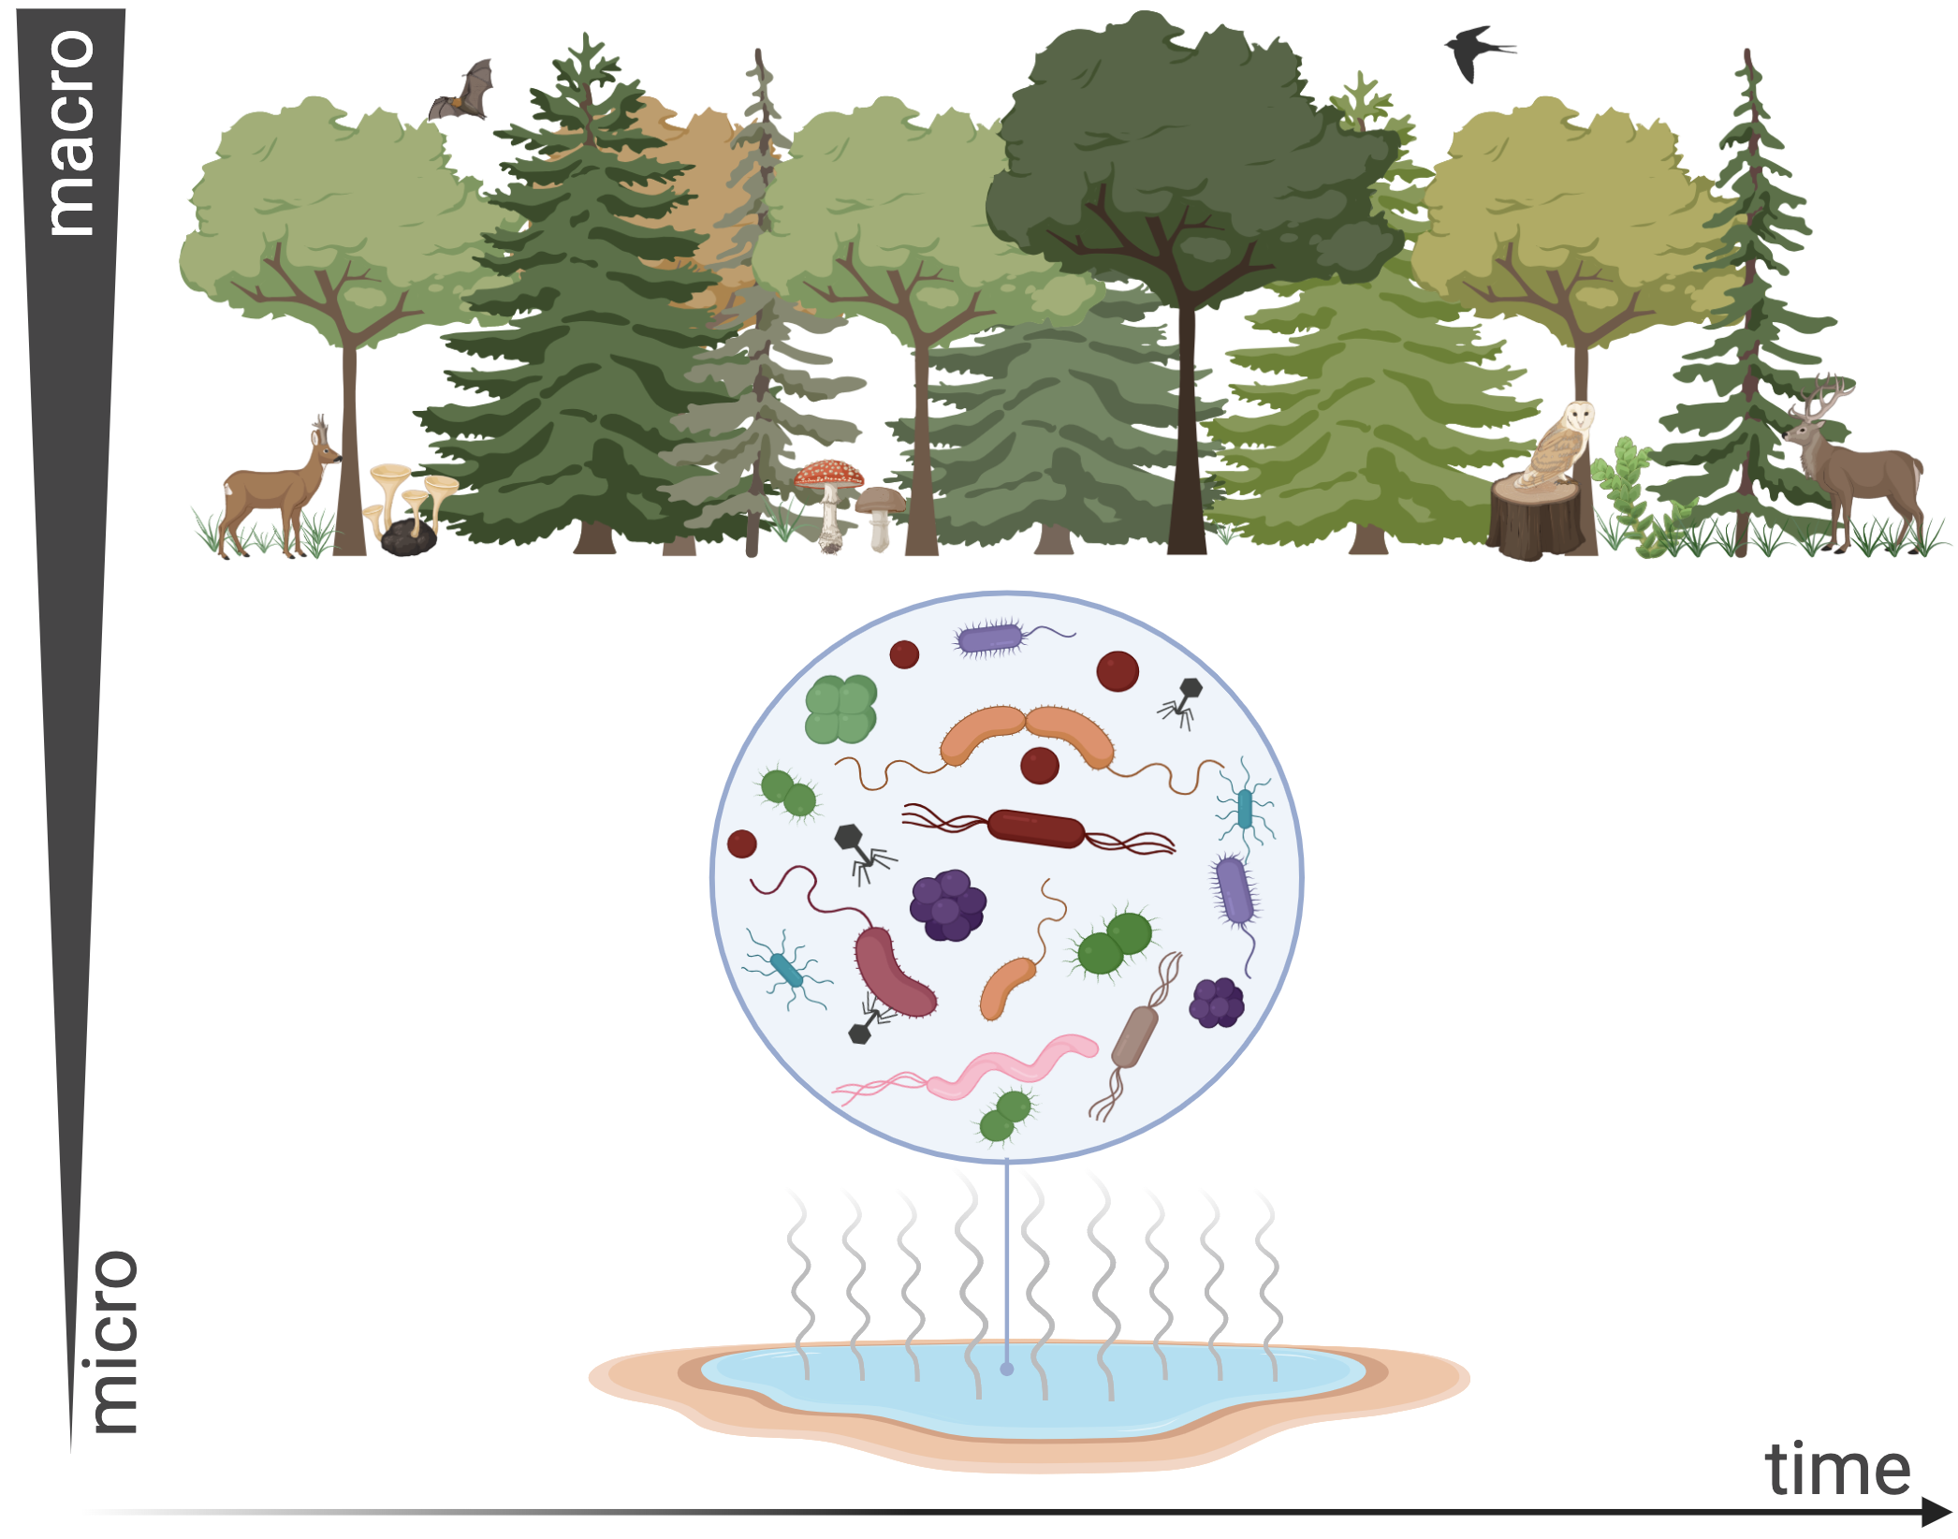
Biodiversity and Ecosystem Functioning
….and the capture of resources
Prof Sophie Nixon
sophie.nixon@manchester.ac.uk; John Garside Building

Slide 2
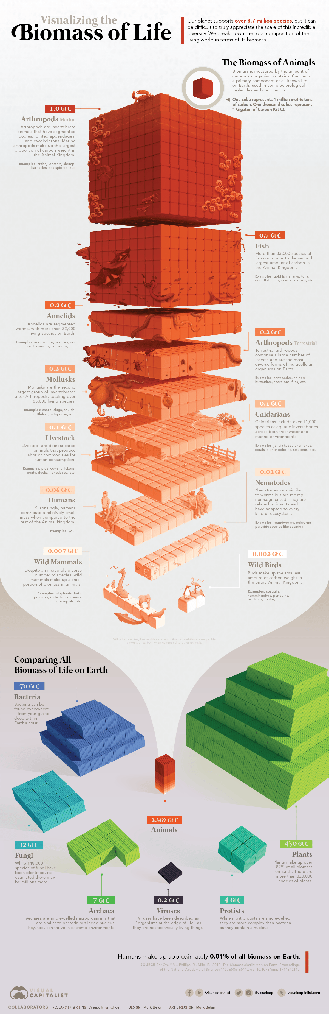
Life on Earth

Slide 3

But what about life in Earth?
“Essentially, all life depends on the soil ... There can be no life without soil and no soil without life; they have evolved together.”
Charles E. Kellogg, USDA Yearbook of Agriculture, 1938

Slide 4

Increasing political and societal interest in soils
The Rt Hon Michael Gove MP
Former Secretary of State for Environment, Food and Rural Affairs
“We need to replenish depleted soil, plant trees, support wetlands and peatlands, rid seas and rivers of rubbish, reduce greenhouse gas emissions, cleanse the air of pollutants, develop cleaner, sustainable energy and protect threatened species and habitats. “

Slide 5
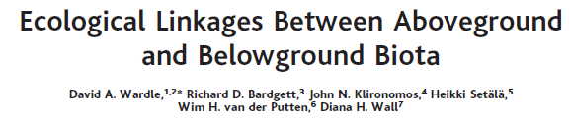
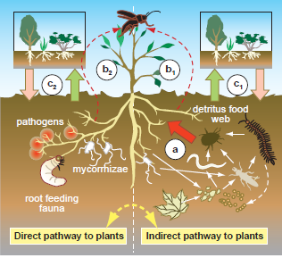

Slide 6
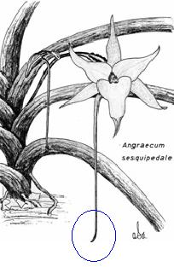

And remember INTERACTIONS are important!
Example: Coevolution of orchid and hawk moth
Charles Darwin wrote:
"A whip-like green nectary of astonishing length hangs down beneath the labellum. In several flowers sent me by Mr. Bateman I found the nectaries eleven and a half inches long, with only the lower inch and a half filled with very sweet nectar. What can be the use, it may be asked, of a nectary of such disproportional length?
We shall, I think, see that in Madagascar there must be moths with probosces capable of extension to a length of between ten and eleven inches!"
Angraecum sesquipedale

Slide 7
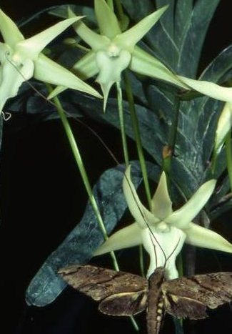
40 years later…
Xanthopan morgani praedicta

Slide 8
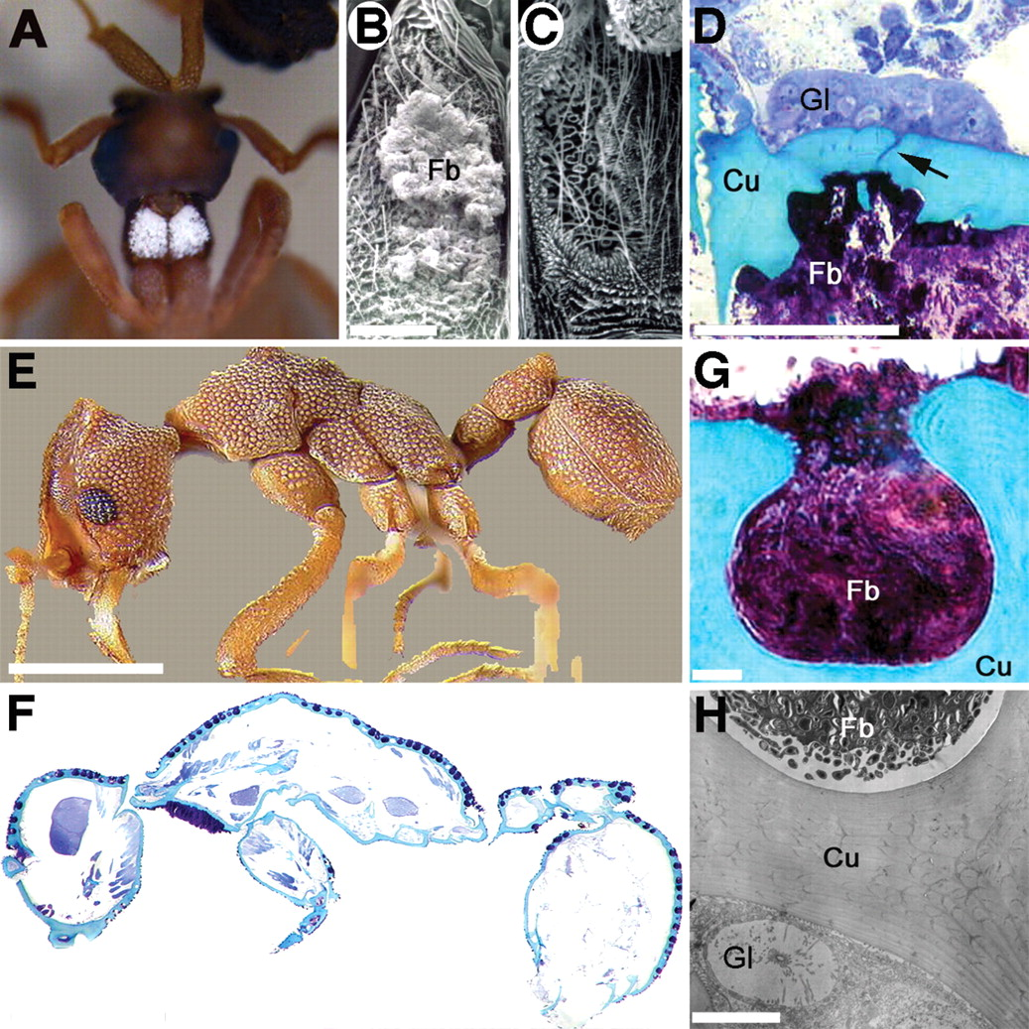
Science 6 January 2006:
Vol. 311 no. 5757 pp. 81-83
DOI: 10.1126/science.1119744
(A) Photograph of Cyphomyrmex costatus showing the bacteria on the propleural plates. SEM of the plates in C. muelleri: The left plate is covered with bacteria (B), whereas they have been removed from the right plate, revealing the underlying fovea (C). (D) Light micrograph of a semi-thin cross section through the propleural plate of C. longiscapus showing the gland (Gl) and duct cells (black arrow) associated with the fovea and the bacterium (Fb) on the plate (Cu for cuticle). (E) Photograph of C. longiscapus, illustrating foveae openings covering most of the cuticle. (F) Sagittal semi-thin section through a C. longiscapus worker, illustrating foveae outlining nearly the entire body of the ant. (G) Light micrograph of a single fovea within the cuticle (Cu) illustrating the abundance of mutualistic bacteria (Fb) within the crypt. (H) TEM of the lower section of a fovea showing a single glandular cell (Gl) and bacteria (Fb) within the crypt. Scale bars: 50 μm(A toC), 5 μm (E and G), and 0.5 mm (F). [Photograph in (A) by A. Little]

Slide 9
The importance of biodiversity
Much of society does not want to see species go extinct: individual species have an inherent ‘value’ (some more than others!)
Where there are strong species interactions (e.g. the hawk moth example), loss of one species will have a negative effect on the other
But does biodiversity itself affect the way ecosystems function?

Slide 10
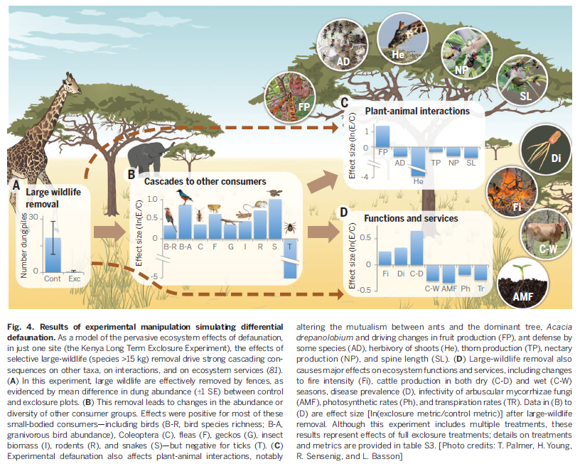


Slide 11
Is there a relationship between biodiversity and ecosystem functioning?
First we need to answer these questions:
What is biodiversity?
What is ecosystem functioning?

Slide 12
Biodiversity
The degree of variation in life
Dependent on SCALE. Gives rise to:
alpha diversity (within a habitat, ecosystem etc)
beta diversity (between ecosystem comparison –the number of unique species)
gamma diversity (within a region, with several ecosystems)

Slide 13

Biodiversity
The number of species (species richness)
The relative abundance of species (evenness)
diversity sensu stricto uses an index of both richness and evenness, e.g. Shannon index
H’ = diversity; pi = evenness of species i; s = richness

Slide 14
Other measures of biodiversity
Functional type; e.g. organisms classified according to similar “traits”.
Could be morphological characteristics; chemical composition; association with symbionts.
Range form quite specific to quite broad – user defined.
e.g. grasses; forbs; sedges; heathers

Slide 15
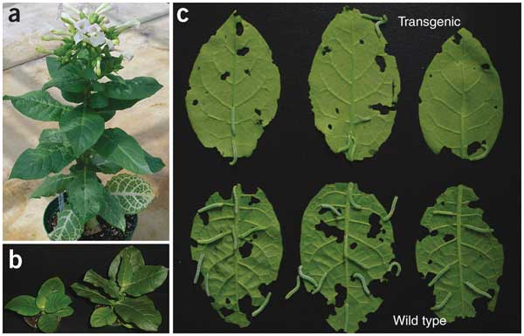
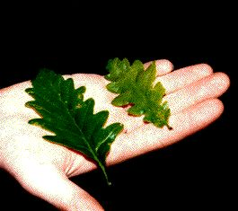

Slide 16
Ecosystem functioning
Any measure of the performance of an ecosystem
Depends on individual perspective
Ecosystem functions may therefore oppose each other.
e.g. productivity; reproduction; leaching of nutrients; decomposition; carbon storage

Slide 17
Linking BEF
Discovering if there is a predictable link between biodiversity and ecosystem functioning is a major goal in ecology.
Function
Diversity

Slide 18
Why should there be a relationship between BEF?
Niche differentiation.
Antagonism
Facilitation

Slide 19
Important niches for plants and mycorrhizal fungi at local scales
Plants
Light
Rooting depth
Soil properties (pH, nutrients, water etc)
Grazing pressure
Mycorrhizal fungi
Mycorrhizal fungi
Host plant species
Soil properties (pH, nutrients, water etc)
Disturbance

Slide 20
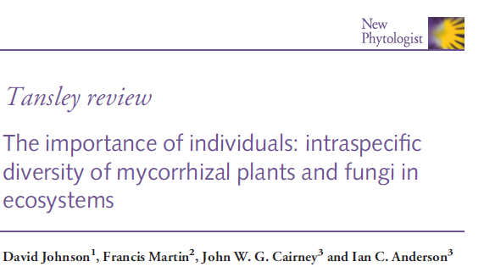
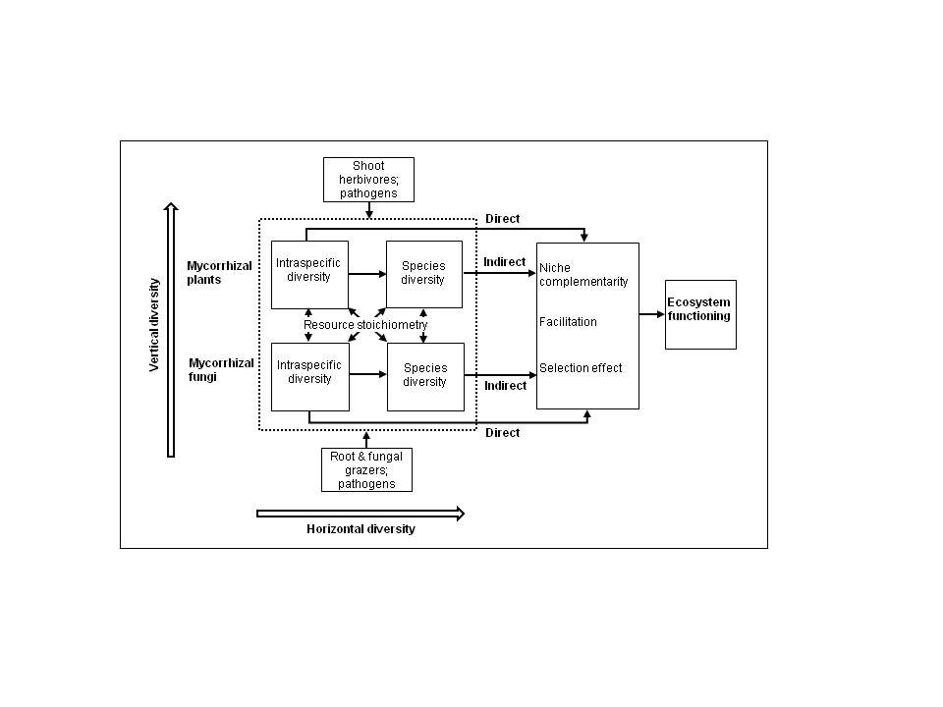

Slide 21
Linking Biodiversity with Function
Easier to test for some species than others (plants versus microbes)
Need to test across several taxonomic groups because relationships may not hold (e.g. different morphology, abundance, physiology and reproduction of microbes versus plants)

Slide 22
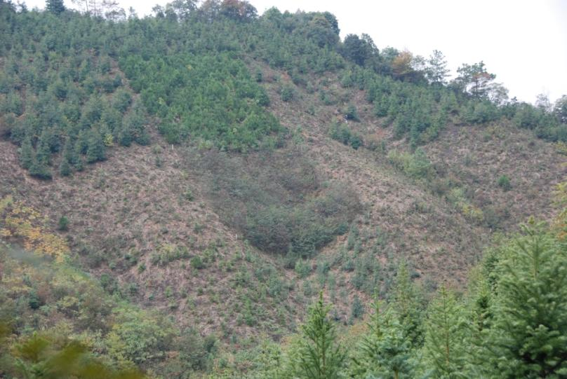
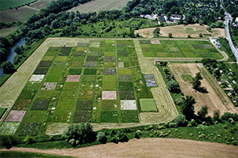
How do you test for relationships between biodiversity and ecosystem functioning? Big scale:
BEF China
Jena biodiversity experiment

Slide 23
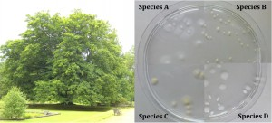
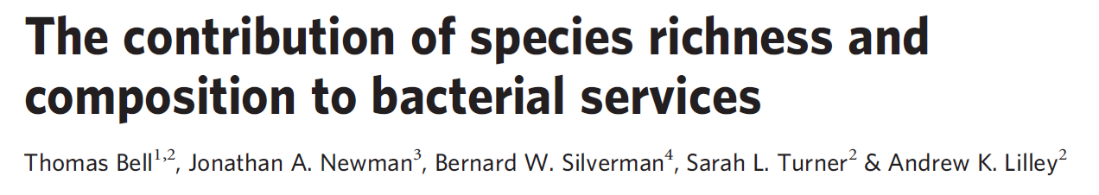
Small scale – Thomas Bell work

Slide 24
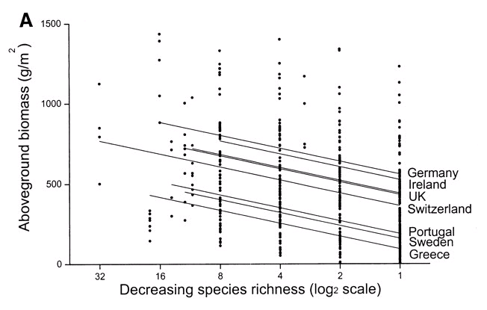
Plant diversity & ecosystem function
Many studies have focused on above-ground components, such as plant productivity.
Hector et al. 1999 Science

Slide 25
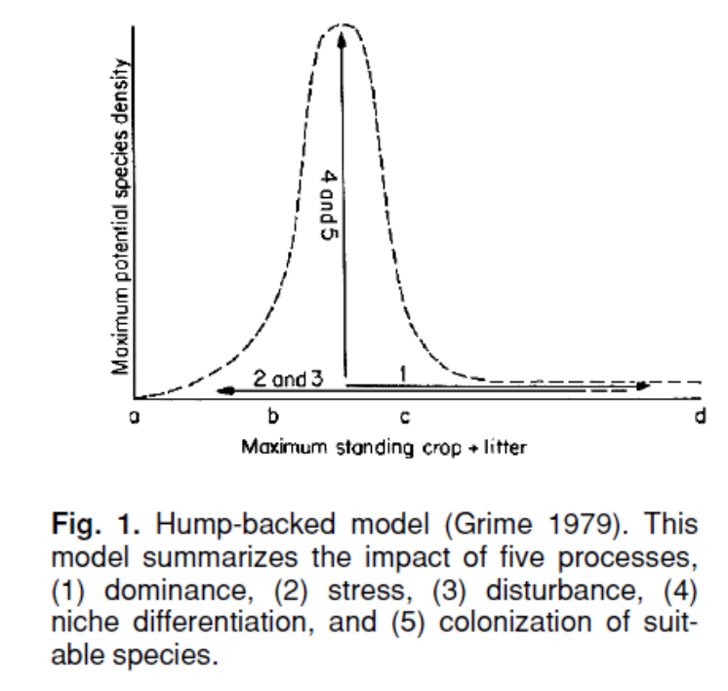

Lots of debate about the nature of the relationship – often related to the nature of the experimental design. Just because a piece of work is published, does not mean it has no “issues”!

Slide 26
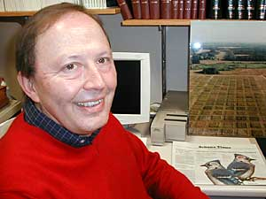
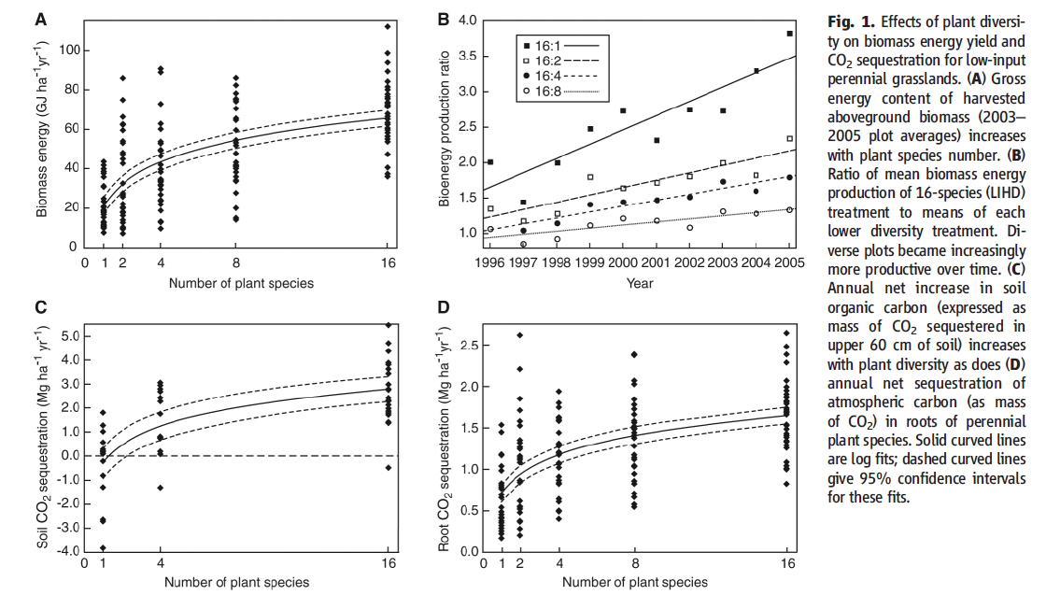
Species richness and biofuel production -David Tilman et al Nature

Slide 27
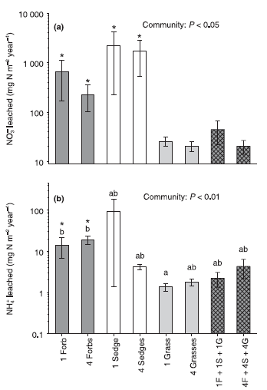
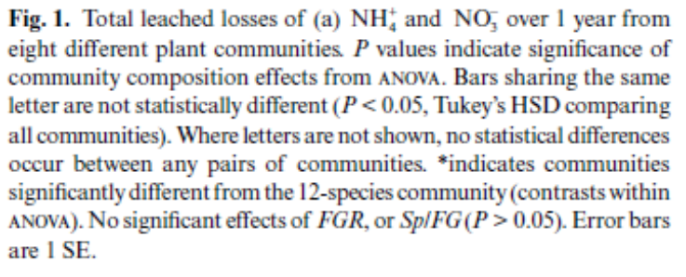
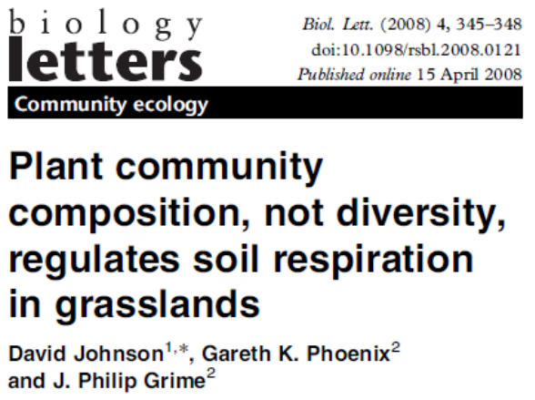
Consider other aspects of “diversity”
Nitrogen leaching
Soil respiration

Slide 28
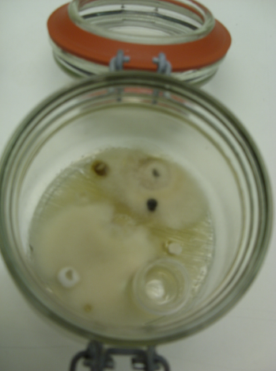
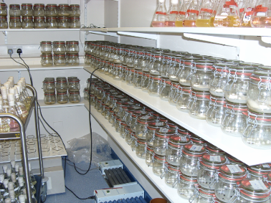
A role for intra- and inter specific diversity of mycorrhizal fungi in regulating nutrient cycles?
C. geophilum
Each experiment had 270 microcosms containing 1, 2, 4 or 8 ECM species to create a gradient of richness;
Biomass and CO₂ efflux measured.
P. involutus
L. rufus
L. bicolor
C. glaucopus
A. muscaria
S. bovinus
NaOH Trap
H. crustuliniforme

Slide 29
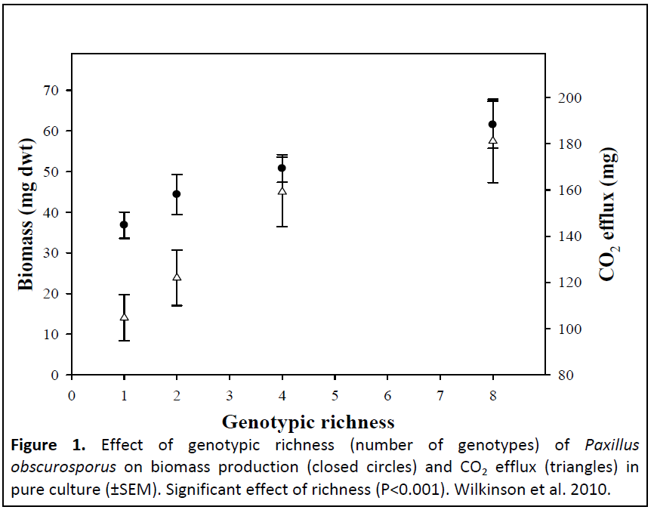
Intraspecific diversity regulates fungal productivity
and respiration
Wilkinson et al. (2010), PLoS ONE 5, e12604
Notes:
My next approach used the same experimental design as the previous study but this time i tested the effects of genotypic richness on community respiration and productivity. I created a diversity gradient of 1 to 8 genotypes of Paxillus obs and i also used the same 3 C:N ratios.
First graph shows that genotype richness had a significant positive effect on biomass production and biomass production in the 8 genotype mixes was 50% greater that the monocultures. The effects of genotype richness were also much more significant than the four-fold manipulation in C:N ratio. However, Paxillus spp. are known to grow well where N is plentiful and so it is possible that other species may have a different response.
The effects of intraspecific richness were underpinned by strong effects of individuals and an interaction with C:N ratio.

Slide 30
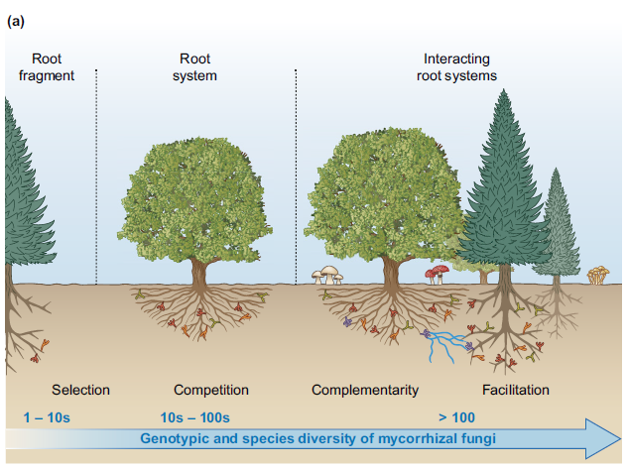
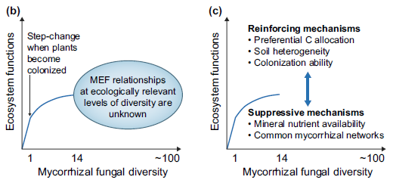
Biodiversity-ecosystem function relationships in mycorrhizal systems remain poorly studied
Spatial scale a key factor
Hazard and Johnson New Phytologist 2018

Slide 31
Increasing interest in ‘traits’
Traits: morphological, anatomical, physiological, biochemical and phenological characteristics of organisms
Used as a ‘functional’ alternative or supplement to taxonomy
Used widely for plants, but increasingly for animals and microorganisms
Traits often measured by multiple studies and compiled into global databases

Slide 32
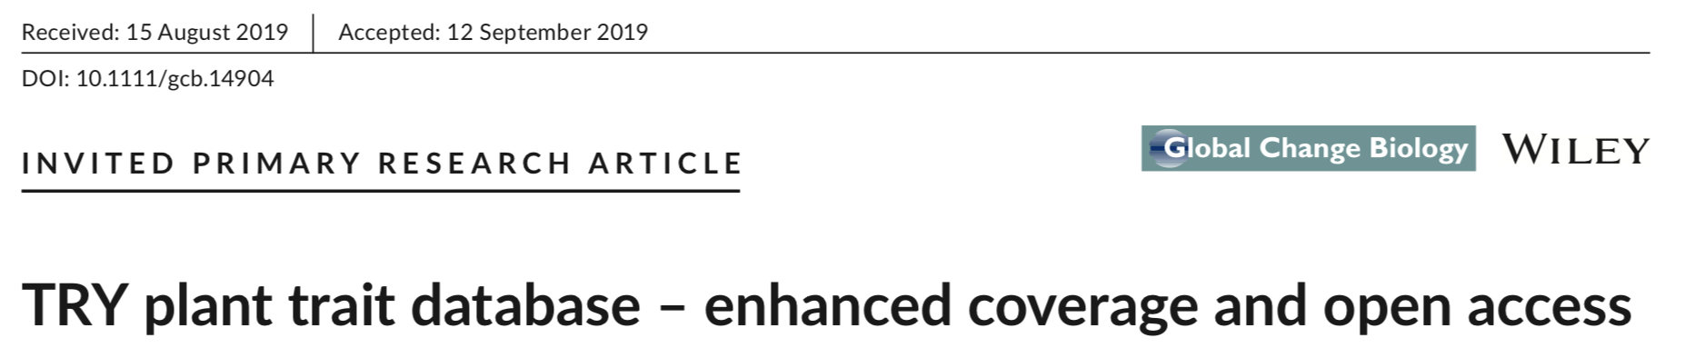
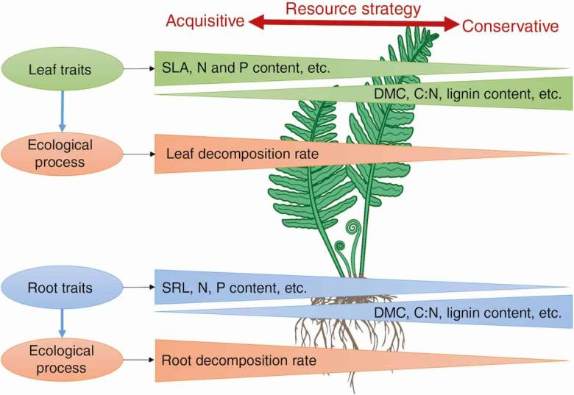
Example: the ‘TRY’ plant database

Slide 33
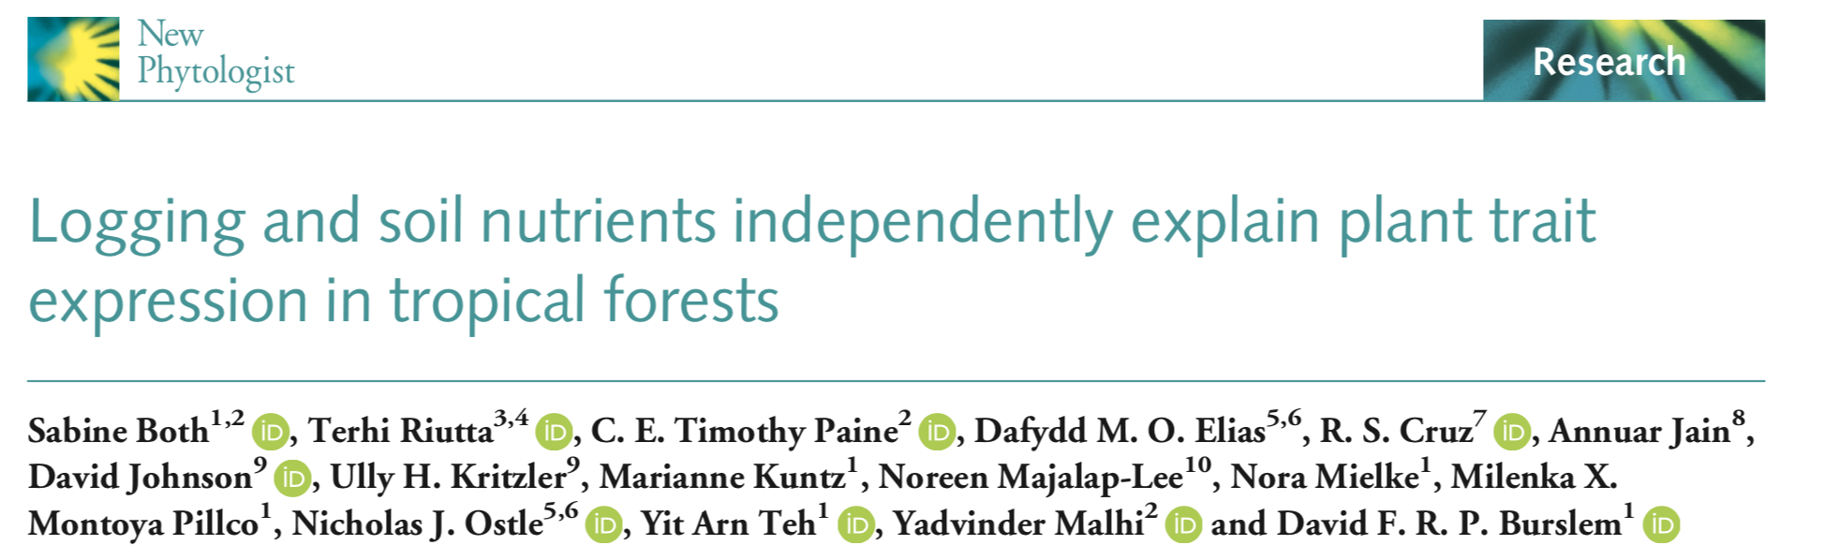
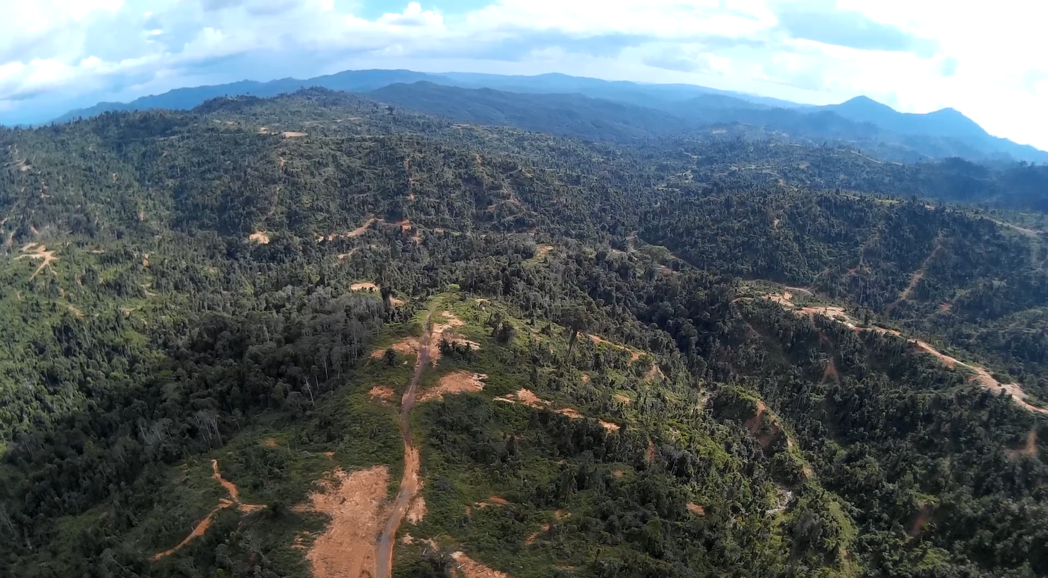

Example showing how environmental and human disturbance affects plant traits

Slide 34
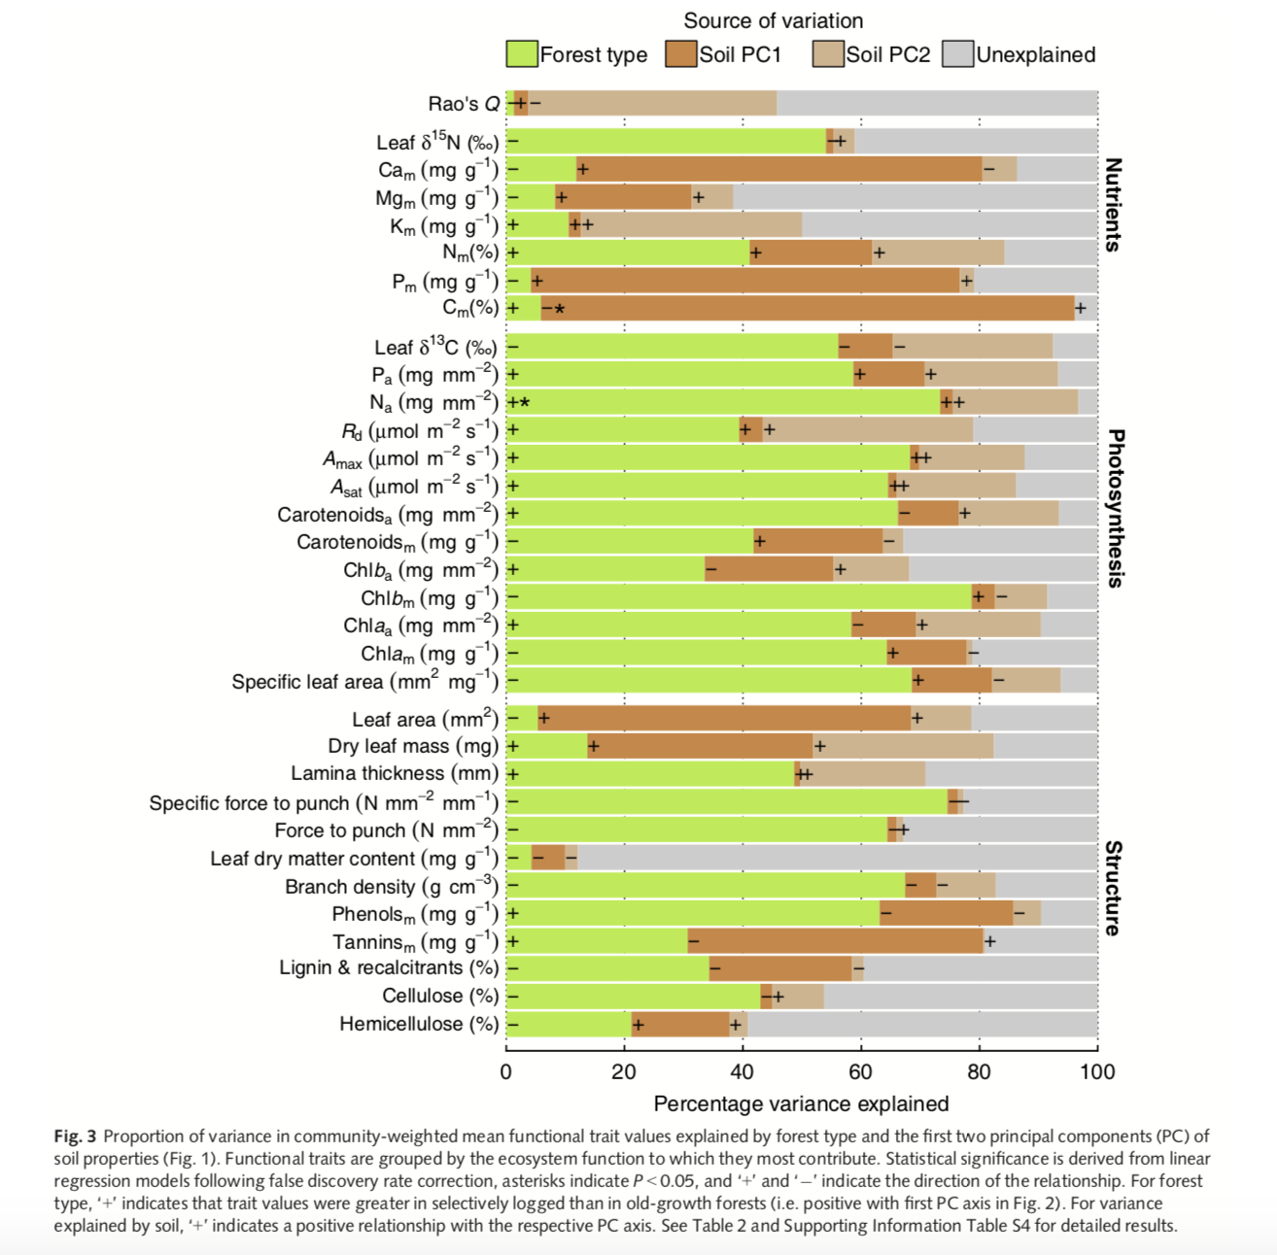
Brown: variation in plant traits explained by various soil properties
Green: variation in plant traits explained by forest type (i.e. logged or unlogged)

Slide 35
A Sustainable Planet:
Phosphorus in soil, food and water
Professor David Johnson
Department of Earth and Environmental Sciences
david.johnson-2@manchester.ac.uk; Michael Smith Building

Slide 36
Aims and topics for this section
The critical role of phosphorus for humanity
Focus on phosphorus in agriculture
How is phosphorus cycled on land and in water
Concepts of co-limitation

Slide 38
The distribution of phosphorus in soil is heterogeneous across large and small scales
César Plaza, Claudio Zaccone, Kasia Sawicka, Ana M. Méndez, Ana Tarquis, Gabriel Gascó, Gerard B. M. Heuvelink, Edward A. G. Schuur & Fernando T. Maestre “Soil resources and element stocks in drylands to face global issues” Scientific Reports 8: 13788 (2018)

Slide 39
Conversion of organic phosphorus to inorganic phosphorus
Phosphatases: a family of different enzymes that catalyse mineralisation of different forms of organic phosphorus
e.g. phosphomonoestases; phosphodiesterases
Produced by plants, microbes, animals

Slide 40
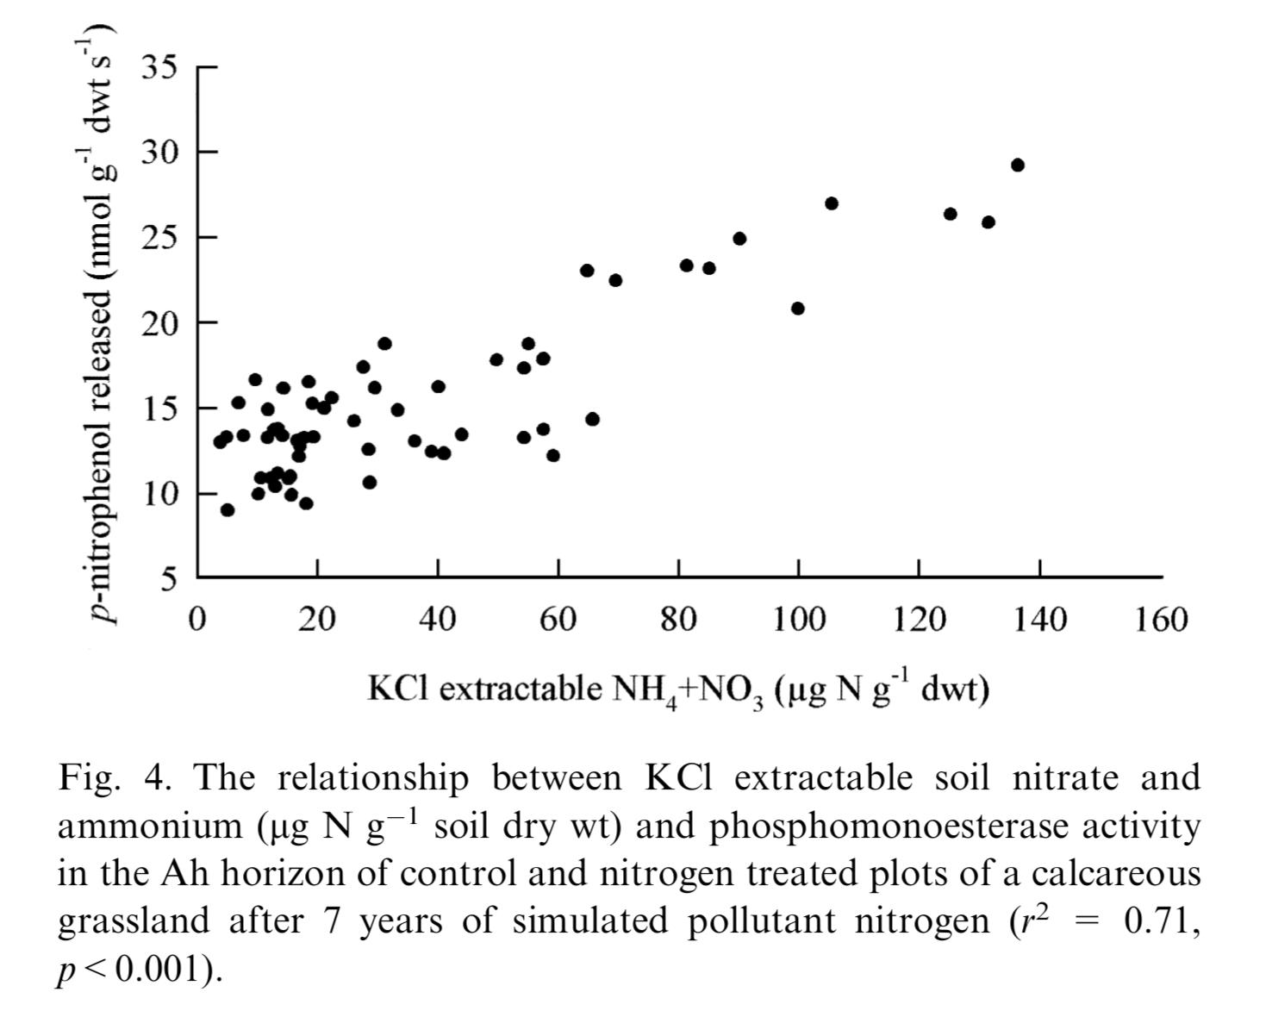
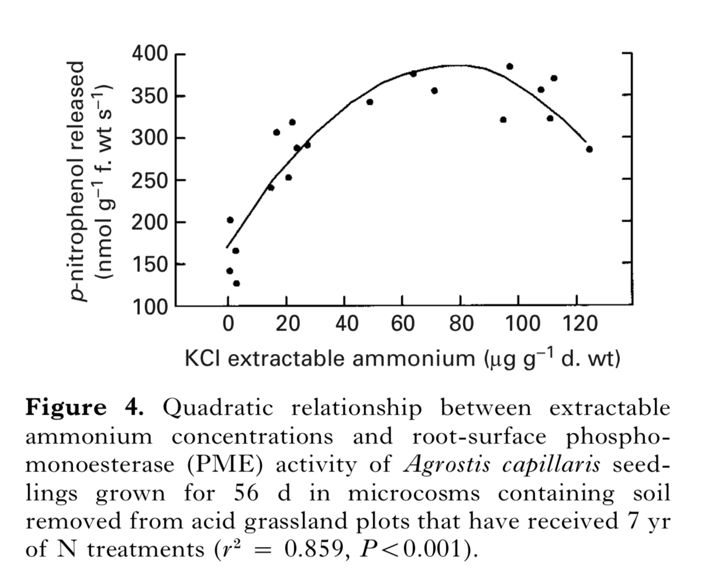
The activity of the suite of enzymes called “phosphatases” are related to nitrogen concentrations

Slide 41
Many factors regulate phosphorus uptake by plants
Phosp
DOI: https://doi.org/10.1104/pp.111.175232

Slide 42
Phosphorus is ‘sticky’
It is strongly absorbed to the surfaces of particles by ionic forces
It forms complex molecules, some of which are very insoluble or chemically complex
Phosphorus is more difficult for plants to take-up than e.g. nitrate
As a result, applications of phosphorus to soil can build-up, leading to a legacy effect if the additions stop

Slide 43
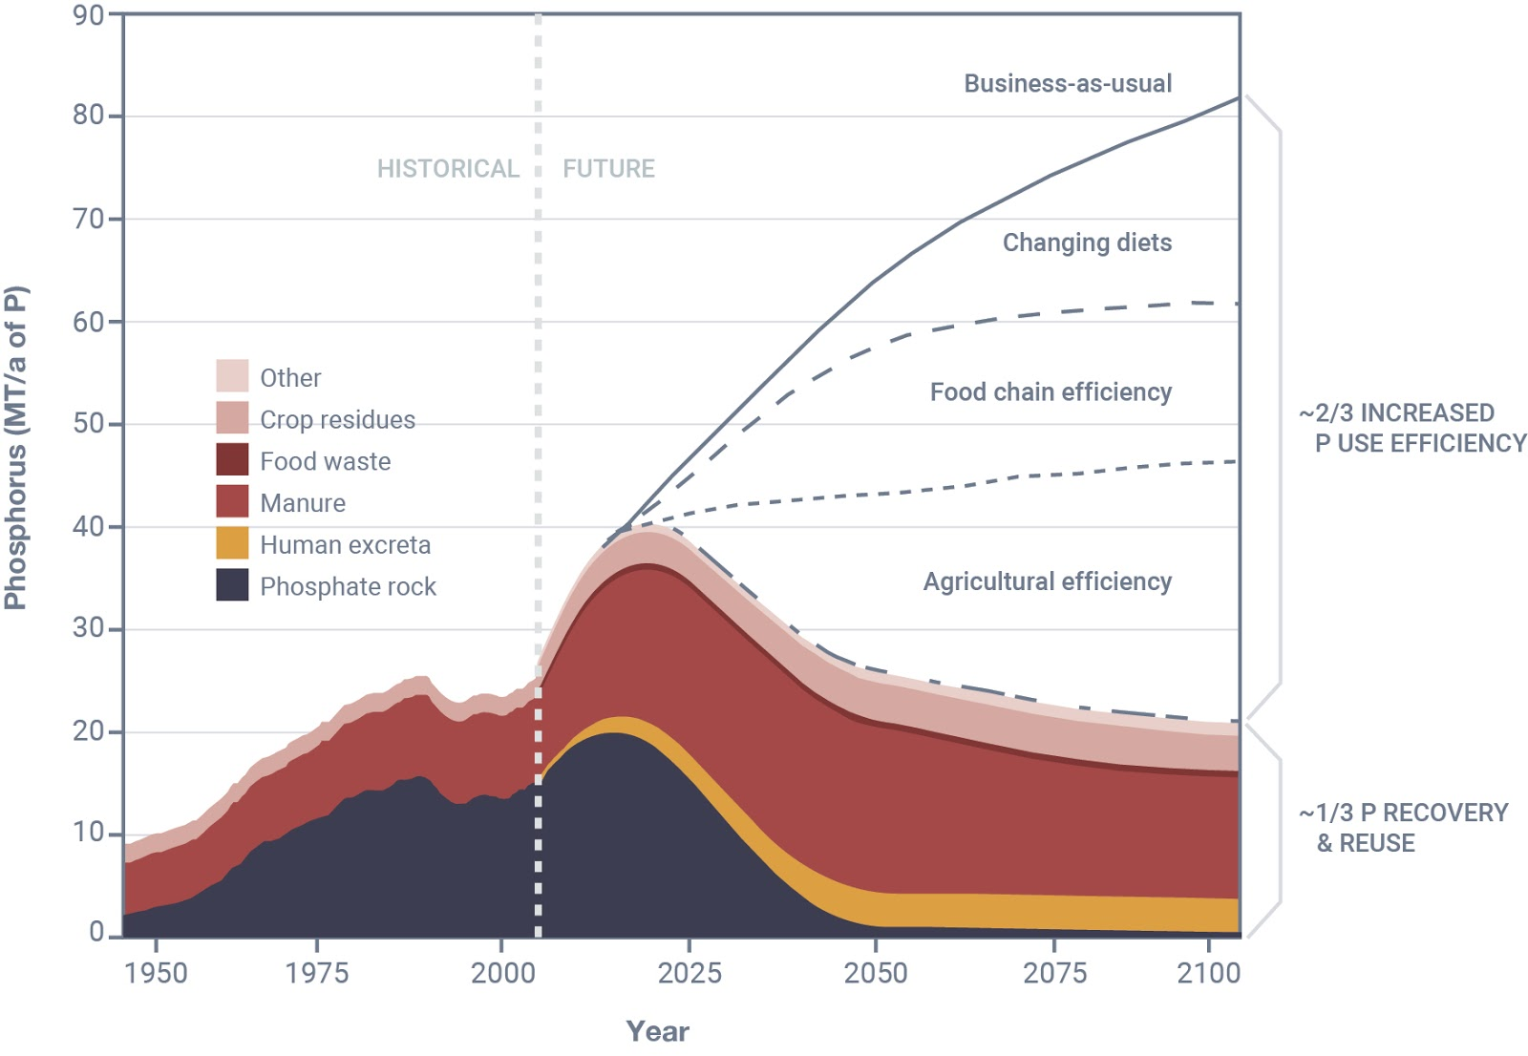
There’s no single ‘silver bullet’ to solve our phosphorus supply crisis
From Cordell et al. (2009)

Slide 44
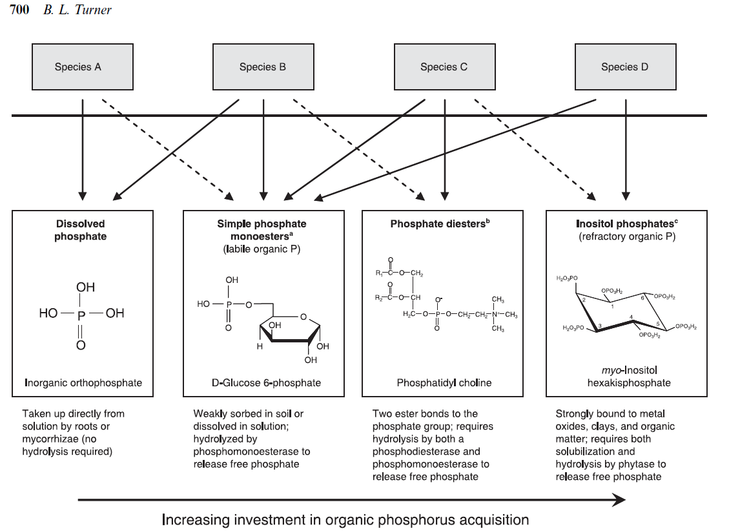
But just how dependent really are plants on inorganic forms of phosphorus?
Soils contain a VAST diversity of different forms of phosphorus

Slide 45
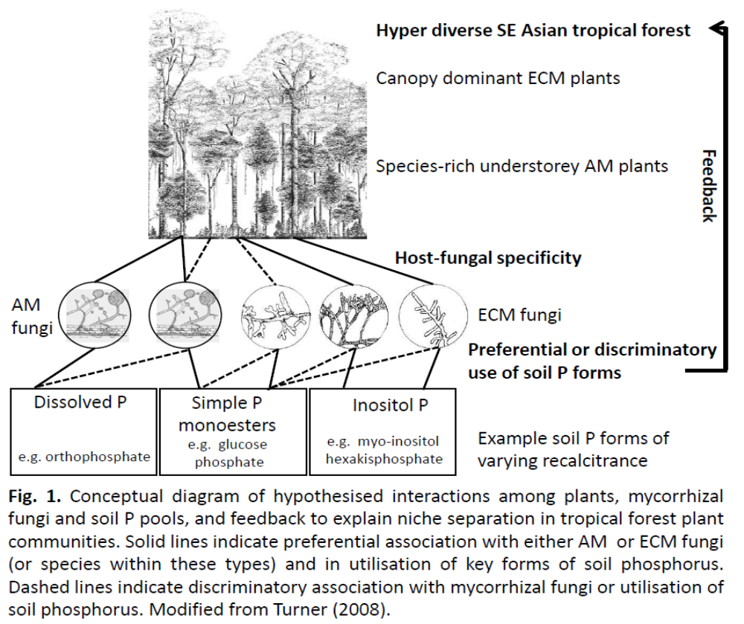
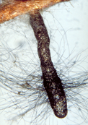
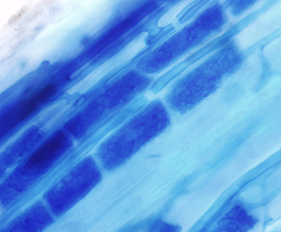
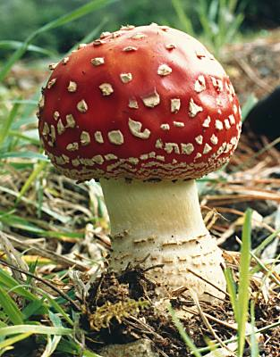

Niche partitioning for phosphorus between mycorrhizal type?
Xubing Liu
Joe Taylor
David Burslem
Andy Taylor
Thorunn Helgason

Slide 46
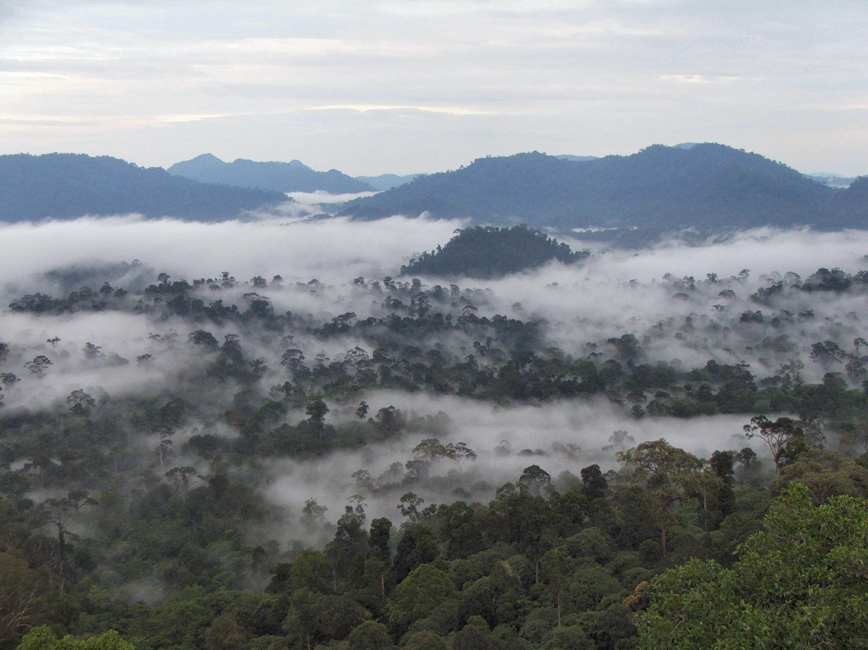
Hyper-diverse: ~150 tree species per ha
Subject to logging: selective removal of dipterocarps → total destruction

Slide 47
One way to test this hypothesis is to grow plants with specific P substrates
No added P (low P sand/peat mix)
Sodium orthophosphate (SP)
D-glucose-6-phosphate (D6GP)
Phytic acid, sodium salt (PASS)
A mix of SP, D6GP and PASS
Increasing complexity and diversity

Slide 48
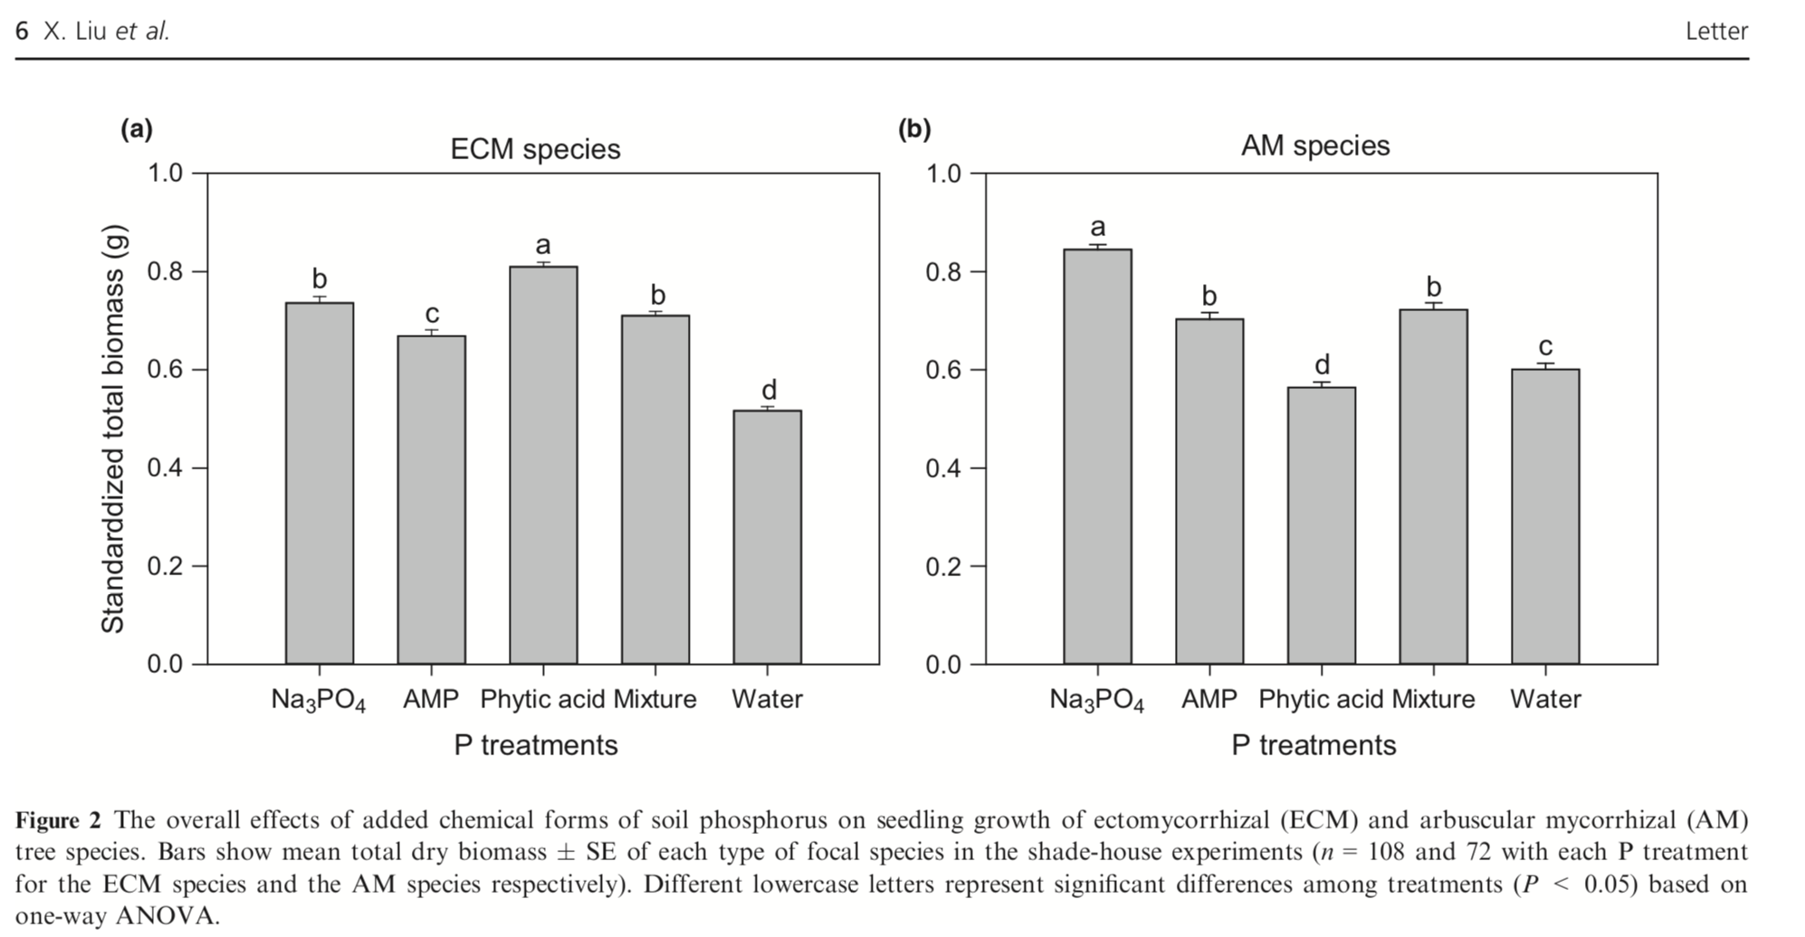
Plant biomass differed significantly in response to P form and mycorrhizal type

Slide 49
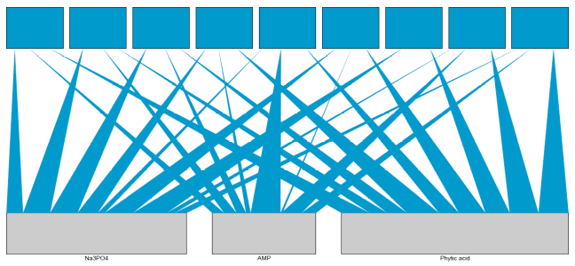
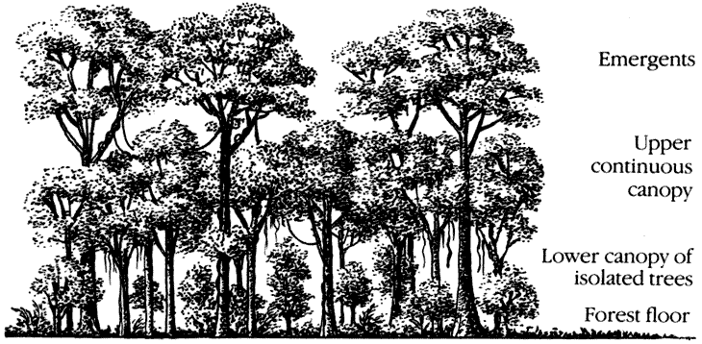
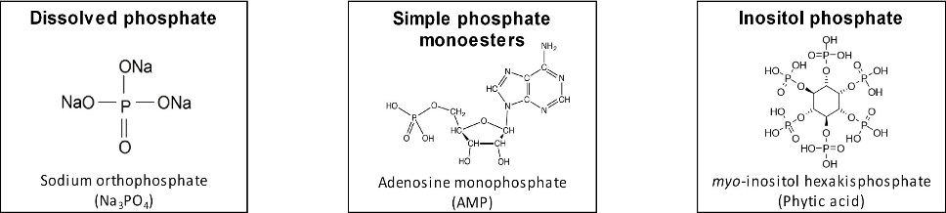
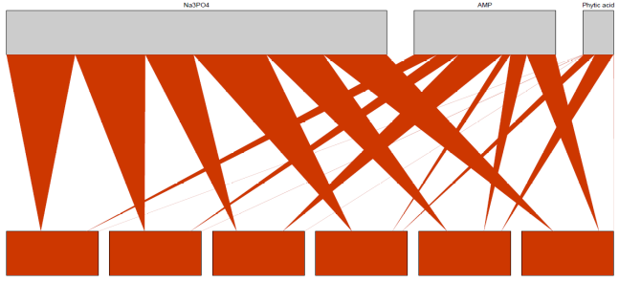
CFIS
CFAB
EFEN
SMUL
SARG
SPAR
DLAN
PTOM
VASP
Canopy dominant ECM trees
Na₃PO₄
AMP
Phytic acid
ECM plants: Increasing preference
AM plants: Increasing preference
Na₃PO₄
AMP
Phytic acid
Species-rich
understorey AM plants
SSUP
CCON
CPAU
OGLA
MASP
APAV
Size of P source reflects overall use by either ECM or AM plants;
Thickness of wedges use of P source by each species

Slide 50
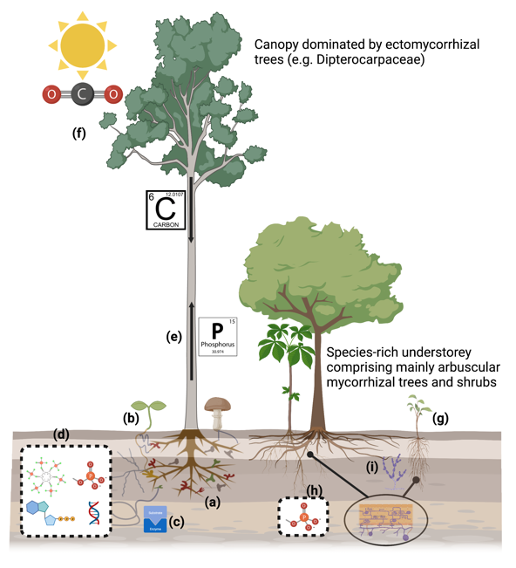
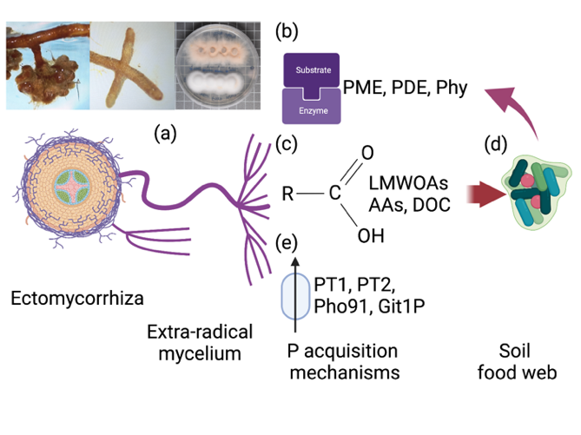
A symbiotic pathway to canopy dominance?
Large investment of carbon to mutualists
Extensive hyphae
Effective CMN
Pathogen protection
Seedling survival
Access to P
Seedling growth
D Johnson et al 2023 Trends in Plant Science

Slide 51
This part of the soil phosphorus cycle urgently needs revisiting!

Slide 52
Remember the link between nitrogen availability of phosphatase activity?
Elemental cycles (C, N and P for example) do not operate independently
E.g. P demand is related to N supply. Plant growth can be co-limited by N and P, as well as by each of the elements
So adding N to a system (on purpose or accidently) may have consequences for how P is cycled

Slide 53
Summary
Phosphorus is just one of Earth’s elements; but an important one!
The way we manage its use is an exemplar of other resources
More efficient use of phosphorus requires multi-system approach including expertise in soil science, plant science, earth science, hydrology, food chains, dieticians, technology….

Slide 54
^{Summary}
Biodiversity in its broad sense encompasses many aspects of variation in life (genes, genotypes, species, genera, functional types).
Some of this variation is effectively captured by measuring ‘traits’
Plant functional type has a key role in determining free-living and symbiotic microbial function and diversity in grasslands.
The mechanisms behind these relationships are poorly understood
The nature of the relationship between diversity and function is not always positive and linear
Biodiversity is being valued increasingly by society and politicians, and even by economists.

Slide 55
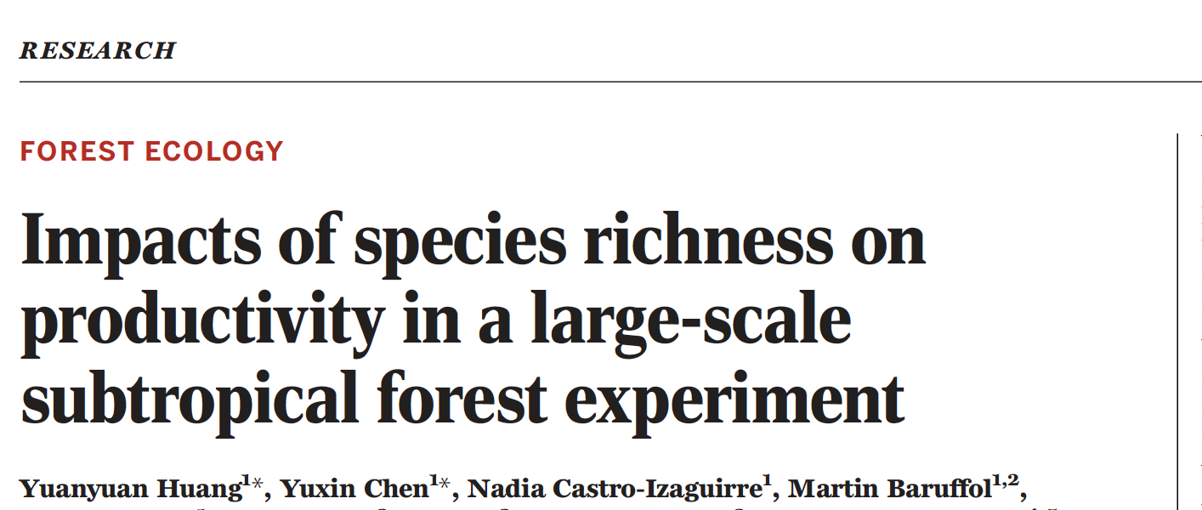
Publication of the Week!
DOI: 10.1126/science.aat6405
https://bef-china.com

Slide 56


Slide 57


Slide 59

Key results: observed data (left) and statistical predictions of means and standard deviations (right)
Tree species richness
Tree species richness

Slide 60
Questions to ask yourself
What processes could explain the relationships between tree diversity and productivity?
How could this study inform forest planting and conservation strategies?
Would you expect the patterns observed to continue over time?
Would you expect the patterns observed to be the same if more species were used per plot?

